Slide 1


ECEN 403 Power & UI Subsystem
GPT NLP Lab Assistant Team #: 35 Muhammed Faseeh
Michael Fritzer
David Haybarger
Kevin Lee
TA: Fahrettin Ay

Slide 2
Project Execution & Validation
Validation – Muhammed Faseeh
Test Name | Validation
Battery Pack Creation | Pack provides ≥14.6 V max, safe charging/discharging
Jetson Buck Converter | Fails, Possible issues (bad solder or mosfet wrong orientation, fried a component)
ESP-32 Buck Converter | Provides ~3.3V with a max of 2A at the Load. The range should be 12.6-16.8 but I think the enable calculations could have been off because it turns on around 15.1.
Servo 1 & 2 Buck Converter | I shorted Servo 2 and Servo 1 is definitely a poor solder job on the inductor portion.
Servo 3 Buck Converter | The voltage is correctly 8V but when inducing a load it drops to almost 0. Solder issue most likely.
UI Functionality | Front end UI with a temporary backend that ties together everything. API and integration will be taken care of next semester.

Slide 3
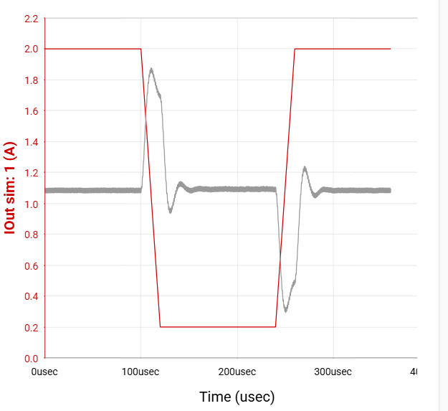
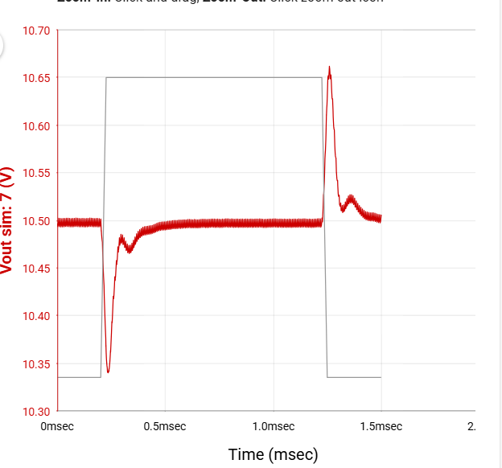
Power System – Muhammed Faseeh
TI - WEBENCH
ESP-32: Low Load High Load
Jetson:

Slide 4
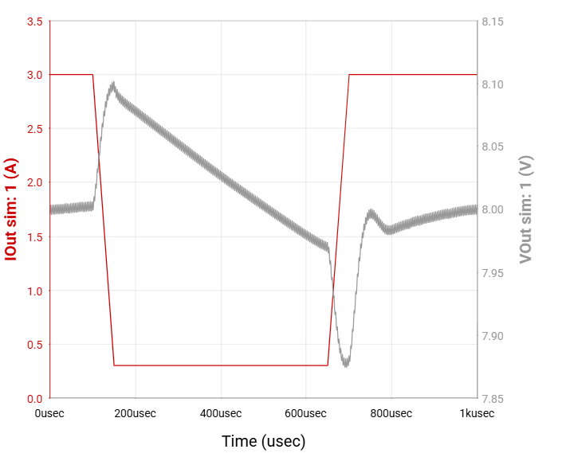
Power System – Muhammed Faseeh
TI - WEBENCH
Servos:

Slide 5
UI – Muhammed Faseeh
React + Vite + TypeScript + NodeJS (Frontend)
Python WebSocket Server (Camera Feed Backend)
http://localhost:5173/ http://10.246.243.181:5173/

